Slide 1

JC2001 Introduction to Software Engineering
Lecture 8: Software Architecture, design and implementation
Dr Xiao Li xiao.li@abdn.ac.uk (BSc Artificial Intelligence)
Dr Huang Yongchao yongchao.huang@abdn.ac.uk (BSc Business Management and Information Systems)
Dr Edward Chuah thuan.chuah@abdn.ac.uk (BSc Computing Science)

Slide 2
Outline
Architectural design (Chapter 6)
Architectural design decisions
Architectural views
Architectural patterns
Application architectures
Design and implementation (Chapter 7)
Object-oriented design using the UML
Design patterns
Implementation issues
Open-source development

Slide 3
Architectural design

Slide 4
Architectural design
Architectural design is concerned with understanding how a software system should be organized and designing the overall structure of that system.
In agile processes, it is generally accepted that an early stage of an agile development process should focus on designing an overall system architecture.

Slide 5
Architectural design
Chapter 6
Software architectures can be designed at two levels of abstraction, which I call architecture in the small and architecture in the large:
Architecture in the small is concerned with the architecture of individual programs. At this level, we are concerned with the way that an individual program is decomposed into components. This chapter is mostly concerned with program architectures.
Architecture in the large is concerned with the architecture of complex enterprise systems that include other systems, programs, and program components. These enterprise systems may be distributed over different computers, which may be owned and managed by different companies. (Chapters 17 and 18.)
NB: Non-functional requirements had the most significant effect on the system’s architecture.

Slide 6
Architectural design
Advantages of explicitly designing and documenting software architecture:
Stakeholder communication -- The architecture is a high-level presentation of the system that may be used as a focus for discussion by a range of different stakeholders.
System analysis -- Making the system architecture explicit at an early stage in the system development requires some analysis. Architectural design decisions have a profound effect on whether or not the system can meet critical requirements such as performance, reliability, and maintainability.
Large-scale reuse -- The system architecture is often the same for systems with similar requirements and so can support large-scale software reuse. Product-line architectures are an approach to reuse where the same architecture is reused across a range of related systems (Chapter 15).

Slide 7
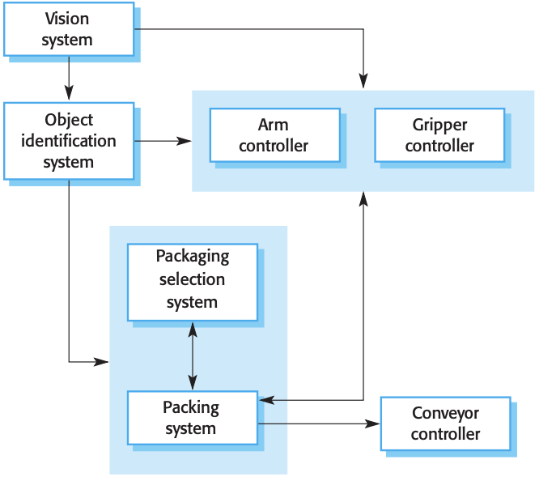
Architectural design
System architectures are often modeled informally using simple block diagrams.
Each box in the diagram represents a component.
Boxes within boxes indicate that the component has been decomposed to subcomponents.
Arrows mean that data and or control signals are passed from component to component in the direction of the arrows.
The architecture of a packing robot control system
Notes:
Simple, informal block diagrams showing entities and relationships are the most frequently used method for documenting software architectures.
But these have been criticised because they lack semantics, do not show the types of relationships between entities nor the visible properties of entities in the architecture.
Depends on the use of architectural models.The requirements for model semantics depends on how the models are used.

Slide 8
Architectural design
Very abstract - they do not show the nature of component relationships nor the externally visible properties of the sub-systems.
However, useful for communication with stakeholders and for project planning.
The architecture of a packing robot control system

Slide 9
Architectural design
Use of architectural models
As a way of facilitating discussion about the system design A high-level architectural view of a system is useful for communication with system stakeholders and project planning because it is not cluttered with detail. Stakeholders can relate to it and understand an abstract view of the system. They can then discuss the system as a whole without being confused by detail.
As a way of documenting an architecture that has been designed The aim here is to produce a complete system model that shows the different components in a system, their interfaces and their connections.

Slide 10
Mock quiz
Which one of the following is an advantage of designing and documenting a software architecture?
A software architecture is a high-level presentation of the system which can be used as a focus for discussion by a range of different stakeholders.
A software architecture can be used to identify errors or bugs in the program.
A software architecture can be used to provide small-scale reuse.
A software architecture supports decision making.
Notes:
Answer is A.

Slide 11
Architectural design decisions
Chapter 6.1
Architectural design is a creative process so the process differs depending on the type of system being developed.
However, a number of common decisions span all design processes and these decisions affect the non-functional characteristics of the system.

Slide 12
Architectural design decisions
During the architectural design process, system architects have to make a number of structural decisions that profoundly affect the system and its development pro- cess.
Is there a generic application architecture that can act as a template for the system that is being designed?
How will the system be distributed across hardware cores or processors?
What Architectural patterns or styles might be used?
What will be the fundamental approach used to structure the system?
What strategy will be used to control the operation of the components in the system?
How will the structural components in the system be decomposed into sub-components?
What architectural organization is best for delivering the non-functional requirements of the system?
How should the architecture of the system be documented?

Slide 13
Architectural design decisions
…
What architectural organization is best for delivering the non-functional requirements of the system?
Performance -- Localise critical operations and minimise communications. Use large rather than fine-grain components.
Security -- Use a layered architecture with critical assets in the inner layers.
Safety -- Localise safety-critical features in a small number of sub-systems.
Availability -- Include redundant components and mechanisms for fault tolerance.
Maintainability -- Use fine-grain, replaceable components.
…
Notes:
Performance If performance is a critical requirement, the architecture should be designed to localize critical operations within a small number of components, with these components deployed on the same computer rather than distributed across the network. This may mean using a few relatively large components rather than small, finer-grain components. Using large components reduces the number of component communications, as most of the interactions between related system features take place within a component. You may also consider runtime system organizations that allow the system to be replicated and executed on different processors.
Security If security is a critical requirement, a layered structure for the architecture should be used, with the most critical assets protected in the innermost layers and a high level of security validation applied to these layers.
Safety If safety is a critical requirement, the architecture should be designed so that safety-related operations are co-located in a single component or in a small number of components. This reduces the costs and problems of safety validation and may make it possible to provide related protection systems that can safely shut down the system in the event of failure.
Availability If availability is a critical requirement, the architecture should be designed to include redundant components so that it is possible to replace and update components without stopping the system. I describe fault-tolerant system architectures for high-availability systems in Chapter 11.
Maintainability If maintainability is a critical requirement, the system architecture should be designed using fine-grain, self-contained components that may readily be changed. Producers of data should be separated from consumers, and shared data structures should be avoided.

Slide 14
Architectural design decisions
There is potential conflict between some of these architectures. For example, using large components improves performance, and using small, fine-grain components improves maintainability. If both performance and maintainability are important system requirements, however, then some compromise must be found. You can sometimes do this by using different Architectural patterns or styles for separate parts of the system.
Evaluating an architectural design is difficult because the true test of an architecture is how well the system meets its functional and non-functional requirements when it is in use. However, you can do some evaluation by comparing your design against reference architectures or generic Architectural patterns.

Slide 15
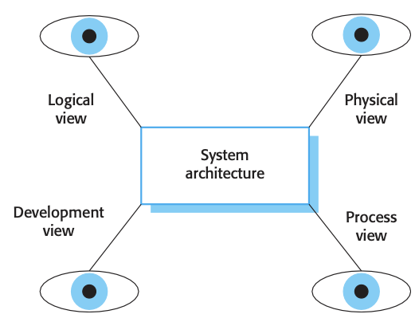
Architectural views
Chapter 6.2
4+1 views or perspectives are useful when designing and documenting a system’s architecture.
Each architectural model only shows one view or perspective of the system.
It might show how a system is decomposed into modules, how the run-time processes interact or the different ways in which system components are distributed across a network. For both design and documentation, you usually need to present multiple views of the software architecture.

Slide 16
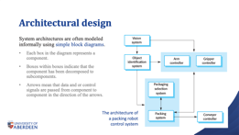
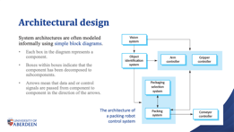
Architectural views
4+1 views or perspectives are useful when designing and documenting a system’s architecture.
(System architecture example)

Slide 17
Architectural views
4+1 views or perspectives are useful when designing and documenting a system’s architecture.
A logical view, which shows the key abstractions in the system as objects or object classes.
It should be possible to relate the system requirements to entities in this logical view.

Slide 18
Architectural views
4+1 views or perspectives are useful when designing and documenting a system’s architecture.
A process view, which shows how, at runtime, the system is composed of interacting processes.
This view is useful for making judgments about non-functional system characteristics such as performance and availability.

Slide 19
Architectural views
4+1 views or perspectives are useful when designing and documenting a system’s architecture.
A development view, which shows how the software is decomposed for development; that is, it shows the breakdown of the software into components that are implemented by a single developer or development team.
This view is useful for software managers and programmers.

Slide 20
Architectural views
4+1 views or perspectives are useful when designing and documenting a system’s architecture.
A physical view, which shows the system hardware and how software components are distributed across the processors in the system.
This view is useful for systems engineers planning a system deployment.

Slide 21
Architectural views
4+1 views or perspectives are useful when designing and documenting a system’s architecture.
Some of the other views may also be developed when different aspects of the system are discussed, although it is rarely necessary to develop a complete description from all perspectives.

Slide 22
Architectural views
Notations used for describing architectural models:
Informal models and notations – (our textbook recommendation)
as long as it's clear
Unified Modeling Language (UML)
The UML was designed for describing object-oriented systems (rather than architecture).
The UML is of most value when you are documenting an architecture in detail or using model-driven development.
Architectural Description Languages (ADLs)
Because ADLs are specialist languages, domain and application specialists find it hard to understand and use ADLs.
…

Slide 23
Mock quiz
Give one reason why UML is unsuitable for describing architectural models?
UML was designed for describing object-oriented systems.
UML was designed to be a standard for describing a system’s architecture.
UML was designed for specifying a system’s components.
UML was designed for describing modern computer architectures.
Notes:
Answer is A.

Slide 24

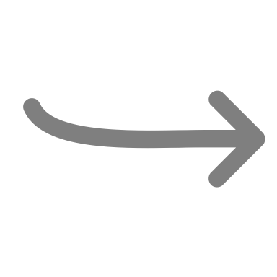
Architectural patterns
Chapter 6.3
An architectural pattern describes a system organization that has been successful in previous systems.
It should include information on when it is and is not appropriate to use that pattern, and details on the pattern’s strengths and weaknesses.
For more detailed information about patterns and their use, you should refer to a published pattern handbooks. We will only introduce some typical architectural patterns.

Slide 25
Architectural patterns -- Model-View-Controller (MVC) pattern
Chapter 6.3.1
Description
Separates presentation and interaction from the system data. The system is structured into three logical components that interact with each other. The Model component manages the system data and associated operations on that data. The View component defines and manages how the data is presented to the user. The Controller component manages user interaction (e.g., key presses, mouse clicks, etc.) and passes these interactions to the View and the Model.

Slide 26
Architectural patterns -- Model-View-Controller (MVC) pattern
Chapter 6.3.1
The organization of the Model-View-Controller
Web application architecture using the MVC pattern

Slide 27
Architectural patterns -- Model-View-Controller (MVC) pattern
Chapter 6.3.1
When used
When there are multiple ways to view and interact with data. Also used when the future requirements for interaction and presentation of data are unknown.
Advantages
Allows the data to change independently of its representation and vice versa. Supports presentation of the same data in different ways with changes made in one representation shown in all of them.
Disadvantages
Can involve additional code and code complexity when the data model and interactions are simple.

Slide 28
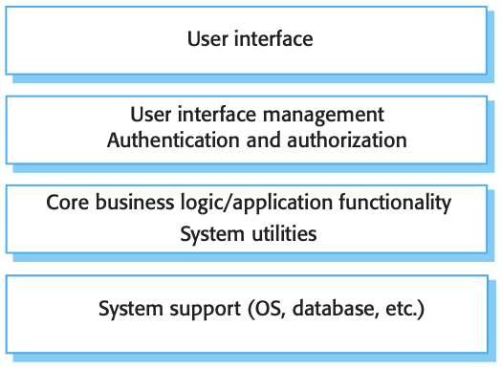
Architectural patterns -- Layered architecture
Chapter 6.3.1
Description
Organizes the system into layers, with related functionality associated with each layer.
A layer provides services to the layer above it, so the lowest level layers represent core services that are likely to be used throughout the system.
When used
when building new facilities on top of existing systems;
when the development is spread across several teams with each team responsibility for a layer of functionality;
when there is a requirement for multilevel security.

Slide 29
Architectural patterns -- Layered architecture
Advantages
Allows replacement of entire layers as long as the interface is maintained.
Redundant facilities (e.g., authentication) can be provided in each layer to increase the dependability of the system.
Disadvantages
In practice, providing a clean separation between layers is often difficult, and a high-level layer may have to interact directly with lower-level layers rather than through the layer immediately below it.
Performance can be a problem because of multiple levels of interpretation of a service request as it is processed at each layer.

Slide 30
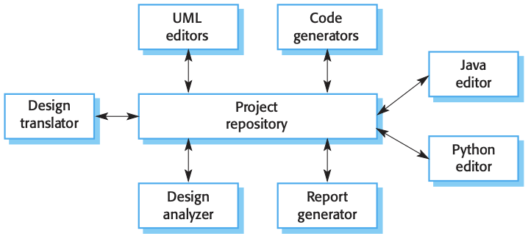
Architectural patterns -- Repository architecture
Chapter 6.3.2
Description
All data in a system is managed in a central repository that is accessible to all system components.
Components do not interact directly, only through the repository.
When used
When a system in which large volumes of information are generated that has to be stored for a long time.
You may also use it in data-driven systems where the inclusion of data in the repository triggers an action or tool.

Slide 31
Architectural patterns -- Repository architecture
Advantages
Components can be independent; they do not need to know of the existence of other components. Changes made by one component can be propagated to all components.
All data can be managed consistently (e.g., backups done at the same time) as it is all in one place.
Disadvantages
The repository is a single point of failure so problems in the repository affect the whole system.
May be inefficiencies in organizing all communication through the repository. Distributing the repository across several computers may be difficult.

Slide 32
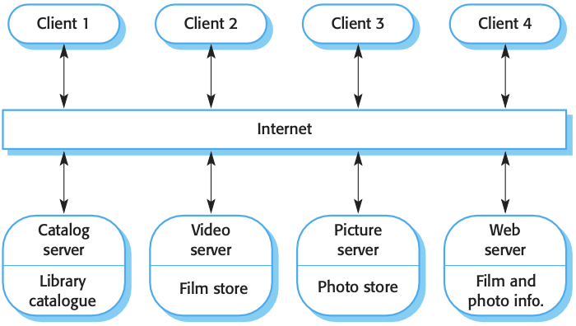
Architectural patterns -- Client–server architecture
Chapter 6.3.3
Description
The system is presented as a set of services, with each service delivered by a separate server. Clients are users of these services and access servers to make use of them.
When used
When data in a shared database has to be accessed from a range of locations. Because servers can be replicated, may also be used when the load on a system is variable.

Slide 33
Architectural patterns -- Client–server architecture
Chapter 6.3.2
Advantages
Servers can be distributed across a network.
General functionality (e.g., a printing service) can be available to all clients and does not need to be implemented by all services.
Disadvantages
Each service is a single point of failure and so is susceptible to denial-of-service attacks or server failure.
Performance may be unpredictable because it depends on the network as well as the system.
Management problems may arise if servers are owned by different organizations.

Slide 34
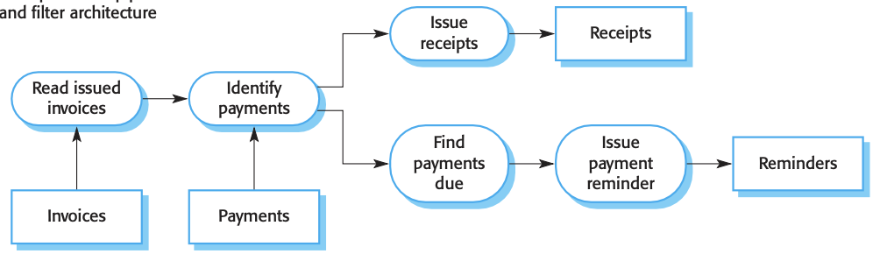
Architectural patterns -- Pipe and filter architecture
Chapter 6.3.4
Description
The processing of the data in a system is organized so that each processing component (filter) is discrete and carries out one type of data transformation. The data flows (as in a pipe) from one component to another for processing.
When used
Commonly used in data-processing applications (both batch and transaction-based) where inputs are processed in separate stages to generate related outputs.

Slide 35
Architectural patterns -- Pipe and filter architecture
Chapter 6.3.4
Advantages
Easy to understand and supports transformation reuse.
Workflow style matches the structure of many business processes.
Evolution by adding transformations is straightforward.
Can be implemented as either a sequential or concurrent system.
Disadvantages
The format for data transfer has to be agreed between communicating transformations. Each transformation must parse its input and unparse its output to the agreed form. This increases system overhead and may mean that it is impossible to reuse architectural components that use incompatible data structures.

Slide 36
Mock quiz
Which of the following are disadvantages of the client-server architecture?
Each service is a single point of failure and is susceptible to denial-of-service attacks.
Performance may be unpredictable because it depends on the network as well as the system.
Management problems may arise if servers are owned by different organisations.
All of the above.
Notes:
Answer is D.

Slide 37
Design and implementation

Slide 38
Object-oriented design using the UML
Chapter 7.1
To develop a system design from concept to detailed (object-oriented design), you need to:
Understand and define the context and the external interactions with the system.
Design the system architecture.
Identify the principal objects in the system.
Develop design models.
Specify interfaces.
We will use a concrete example, an Weather Station System, to explain the design process.
Notes:
*** Students have already learned object-oriented programming, so this part (the following 14 pages) goes by quickly. ***

Slide 39


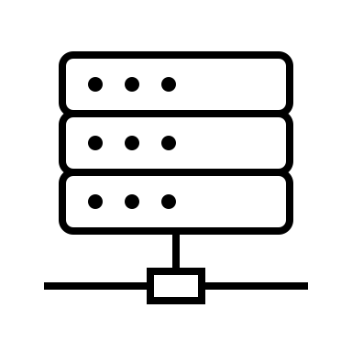

The wilderness weather system
A national weather service wishes to collect weather information from remote areas to help with weather forecasting.
The intention therefore is to develop remote automatic collection systems that are connected to a broader weather information system.
Weather Information System
Satellite
Control System
Weather Stations
Notes:
We develop the software for the weather stations

Slide 40
The wilderness weather system -- A use case example (already collected)
System Weather station
Use case Report weather
Actors Weather information system, Weather station
Data The weather station sends a summary of the weather data that has been collected from the instruments in the collection period to the weather information system. E.g. air temperatures, air pressures, wind speeds etc.
Stimulus The weather information system establishes a satellite communication link with the weather station and requests transmission of the data.
Response The data is sent to the weather information system.
Comments Weather stations are usually asked to report once per hour, but this frequency may differ from one station to another and may be modified in future.

Slide 41
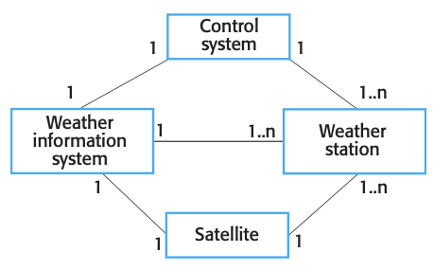
Object-oriented design using the UML 1. System context and interactions
A system context model is a structural model that demonstrates the other systems in the environment of the system being developed.

Slide 42
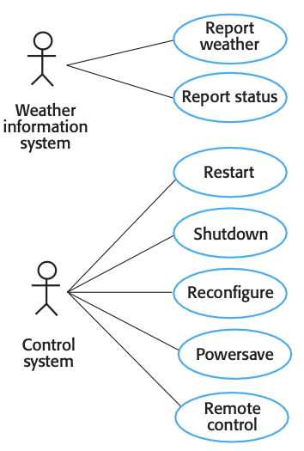
Object-oriented design using the UML 1. System context and interactions
An interaction model is a dynamic model that shows how the system interacts with its environment as it is used.

Slide 43
Object-oriented design using the UML 2. Architectural design
The weather station is composed of independent subsystems that communicate by broadcasting messages on a common infrastructure.
High-level architectural design
Notes:
In the figure, UML package symbol is used to indicate that each system is a collection of components and the separate systems are identified using the UML stereotype «system». The associations between the packages indicate there is an exchange of information but, at this stage, there is no need to define them in any more detail.
The high-level architectural design for the weather station software is shown in Figure 7.4. The weather station is composed of independent subsystems that communicate by broadcasting messages on a common infrastructure, shown as Communication link in Figure 7.4. Each subsystem listens for messages on that infrastructure and picks up the messages that are intended for them. This “listener model” is a commonly used architectural style for distributed systems.
When the communications subsystem receives a control command, such as shut- down, the command is picked up by each of the other subsystems, which then shut themselves down in the correct way. The key benefit of this architecture is that it is easy to support different configurations of subsystems because the sender of a message does not need to address the message to a particular subsystem.

Slide 44
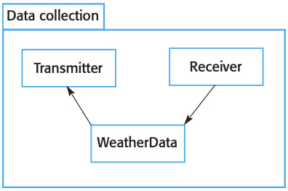
Object-oriented design using the UML 2. Architectural design
The weather station is composed of independent subsystems that communicate by broadcasting messages on a common infrastructure.
Data collection subsystem architectural design
Notes:
The Transmitter and Receiver objects are concerned with managing communications, and the WeatherData object encapsulates the information that is col- lected from the instruments and transmitted to the weather information system. This arrangement follows the producer–consumer pattern, discussed in Chapter 21.

Slide 45
Object-oriented design using the UML 3. Object class identification
Identifying object classes is often a difficult part of object oriented design.
There is no 'magic formula' for object identification. It relies on the skill, experience and domain knowledge of system designers.
Object-Oriented Programming (OOP) knowledge Difficult to identify classes from abstract concepts.
Design patterns We‘ll dive into this topic next week.

Slide 46
Object-oriented design using the UML 3. Object class identification
Identified weather station objects
Notes:
/// here we just show the result with no reason. We'll dive into this topic next week by introduce the design patterns.

Slide 47
Object-oriented design using the UML 4. Design models
Design models show the objects and object classes and relationships between these entities.
There are two kinds of design model:
Structural models describe the static structure of the system in terms of object classes and relationships (e.g. UML Class diagram).
Dynamic models describe the dynamic interactions between objects (e.g. UML Sequence diagram / UML State diagram)..

Slide 48
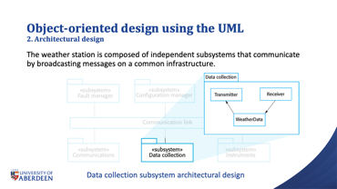
Object-oriented design using the UML 4. Design models -- Subsystem models

Slide 49
Object-oriented design using the UML 4. Design models -- Sequence models

Slide 50
Object-oriented design using the UML 4. Design models -- State diagrams

Slide 51
Object-oriented design using the UML 5. Interface specification
Object interfaces have to be specified so that the objects and other components can be designed in parallel.
Designers should avoid designing the interface representation but should hide this in the object itself.
Objects may have several interfaces which are viewpoints on the methods provided.

Slide 52
Object-oriented design using the UML 5. Interface specification

Slide 53
Case study
A company XYZ keeps track of employees, departments and projects. The company is organized into departments. Each department has a unique name, a unique number, and a particular employee who manages the department. A department may have several locations, and controls a number of projects, each of which has a unique name, a unique number, and a single location. The company stores each employee’s name, Social Security number, address, salary, gender and birth date. An employee is assigned to one department, but may work on several projects. The company maintains records of an employee’s dependents for insurance purposes, including each dependent’s first name, gender, birth date and relationship to the employee.
Identify four use cases.
Draw a UML class diagram for one of the four use cases.
Draw a UML sequence diagram for one of the four use cases.
Notes:
Use cases: Add new employee, Add project, Add dependent, Add department.

Slide 54
Implementation issues
Focus here is not on programming, although this is obviously important, but on other implementation issues that are often not covered in programming texts:
Reuse -- Most modern software is constructed by reusing existing components or systems. When you are developing software, you should make as much use as possible of existing code.
Configuration management -- During the development process, you have to keep track of the many different versions of each software component in a configuration management system.
Host-target development -- Production software does not usually execute on the same computer as the software development environment. Rather, you develop it on one computer (the host system) and execute it on a separate computer (the target system).

Slide 55
Implementation issues -- Reuse
From the 1960s to the 1990s, most new software was developed from scratch, by writing all code in a high-level programming language.
The only significant reuse or software was the reuse of functions and objects in programming language libraries.

Slide 56
Implementation issues -- Reuse levels
The abstraction level
At this level, you don’t reuse software directly but use knowledge of successful abstractions in the design of your software.
The object level
At this level, you directly reuse objects from a library rather than writing the code yourself.
The component level
Components are collections of objects and object classes that you reuse in application systems.
The system level
At this level, you reuse entire application systems.

Slide 57
Implementation issues -- Reuse costs
The costs of the time spent in looking for software to reuse and assessing whether or not it meets your needs.
Where applicable, the costs of buying the reusable software. For large off-the-shelf systems, these costs can be very high.
The costs of adapting and configuring the reusable software components or systems to reflect the requirements of the system that you are developing.
The costs of integrating reusable software elements with each other (if you are using software from different sources) and with the new code that you have developed.

Slide 58
Implementation issues -- Configuration management
Configuration management is the name given to the general process of managing a changing software system.
The aim of configuration management is to support the system integration process so that all developers can access the project code and documents in a controlled way, find out what changes have been made, and compile and link components to create a system.

Slide 59
Implementation issues -- Configuration management
Configuration management activities (you need configuration management tool to handle these activities).
Version management, where support is provided to keep track of the different versions of software components. Version management systems include facilities to coordinate development by several programmers.
System integration, where support is provided to help developers define what versions of components are used to create each version of a system. This description is then used to build a system automatically by compiling and linking the required components.
Problem tracking, where support is provided to allow users to report bugs and other problems, and to allow all developers to see who is working on these problems and when they are fixed.
Notes:
Large IT companies have their own configuration management tools. For individual developers, you can try some simple online tools like git

Slide 60
Implementation issues -- Host-target development
Most software is developed on one computer (development platform ), but runs on a separate machine (execution platform).
Development platform usually has different installed software than execution platform; these platforms may have different architectures.
If your development platform is same with the execution platform, you can debug your software just on your development platform (that is easy).
If your development platform is different from the execution platform, you have to use specific develop/debug tools (e.g. simulators or specific hardware).

Slide 61
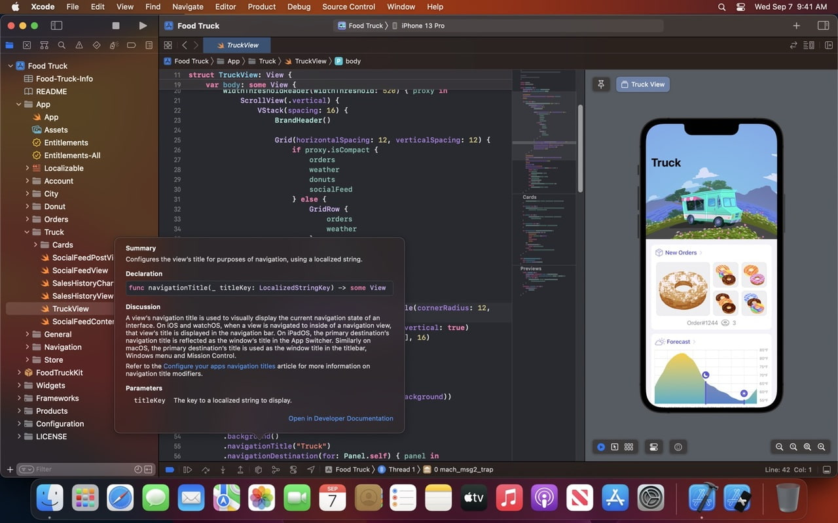
Xcode (iphone development env) with iphone simulator

Slide 62
Lessons learned
A software architecture is a description of how a software system is organized.
Architectural design decisions include decisions on the type of application, the distribution of the system, the architectural styles to be used.
Architectural patterns are a means of reusing knowledge about generic system architectures. They describe the architecture, explain when it may be used and describe its advantages and disadvantages.
We reviewed the Object-oriented design process using UML.
We introduced the implementation issues. Especially, when developing software, you should always consider the possibility of reusing existing software, either as components, services or complete systems.

